Slide 1
Continuous Curriculum Learning for RL
Andrea Bassich, Daniel Kudenko
SURL 2019
12/08/2019

Slide 2
Presentation Outline
Background Info
Introduction to Curriculum Learning
Automating the creation of a Curriculum
Continuous Curriculum Learning
Overview
Decay functions
Curriculum granularity
Results

Slide 3
Curriculum Learning
Introduced by (Bengio et al., 2009) as a machine learning concept to improve the performance in supervised learning
Motivation
Involves training first on “easy” examples, to then go onto incrementally harder examples
Example: Shape recognition
Notes:
“humans and animals learn much better when the examples are not randomly presented, but organized in a meaningful order which illustrates gradually more concepts”
Classifier for ellipses, triangles and rectangles.
Train on regular version of shapes for less variance

Slide 4
Curriculum Learning in RL
Curriculum Learning was first applied to RL by (Narvekar et.al, 2016)
Involves generating a sequence of source tasks, called curriculum, and training the agent on each of them to increase the performance
Assumption on the domain
Creation of source tasks
Source tasks are created by eliminating actions/states, modifying the transition/reward function
Notes:
Training the agent on different tasks
Not something classic RL deals with

Slide 5
Autonomous Task Sequencing for Customized Curriculum Design in Reinforcement Learning (Narvekar et.al, 2017)
Formulate curriculum creation as an MDP
Use Monte Carlo approximation to solve it
The algorithm
Sample from the target task, using the agent’s current policy, figuring out what the agent needs to learn
Create source tasks, using the principles we saw earlier
Recursively break down the source tasks if they are too hard to solve
The task that once learnt changes the policy the most is selected and learnt
Notes:
3. after a number of time steps, no policy convergence/reaches max return if known
Limitations
At every iteration it needs to learn all the sub-tasks to choose one
Limitation of creation of option based sub-goals
Is changing the policy the most always good?

Slide 6
Automatic Curriculum Graph Generation for RL Agents (Svetlik et al. 2017)
A Curriculum is defined as a DAG
Introduction of the Transfer Potential metric
The algorithm
Task elimination and grouping
Intra-Group transfer
Inter-group transfer

Slide 7
Object-Oriented Curriculum Generation for Reinforcement Learning (Da Silva et al., 2018)
Use Object-Oriented MDPs
The environment becomes a collections of objects
A state is a set of instances of different classes
Creation of a curriculum
Randomly select objects from the target task
Build a set of source tasks
Use transfer potential to select tasks that are
Similar to the target task
Dissimilar from other tasks included in the curriculum

Slide 8
Motivation
The Curriculum is normally pre-defined
The tasks in a curriculum tend to be quite different from each other
Normally there is a discrete set of tasks
Curriculum as a continuous change of difficulty
Continuity between adjacent tasks
Possibility of creating the Curriculum as the agent trains

Slide 9
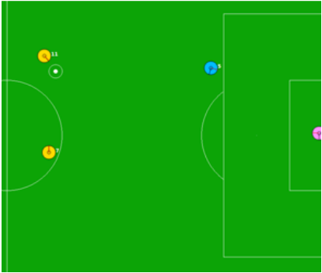
CCL Framework
Domain $D$ with parameter vector $F=[F_{0}, …, F_{n}]$
Ordering $O:D∙F→[0,1]$
Generator $Γ:D ∙F→M$
Decay Function $Δ:args→δ∈[0,1]$
Mapping Function $Φ:δ∈[0,1]→F$
Curriculum is the set of MDPs $M=\{M_{1}, …, M_{i}\}$

Slide 10
The CCL algorithm

Slide 11
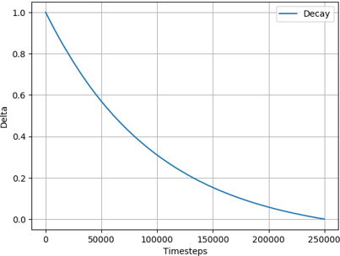
Exponential decay
Decay $δ$ using a fixed schedule
Uses two parameters
$s$: adjusts the speed of the decay
$t_{e}$: the number of steps after which
the decay is complete
$$Delta=Max(\frac{⍺−β}{1−β}, 0)$$
$$⍺=e^{−\frac{t}{t_{e}∗s}} β=e^{−\frac{1}{s}}$$

Slide 12
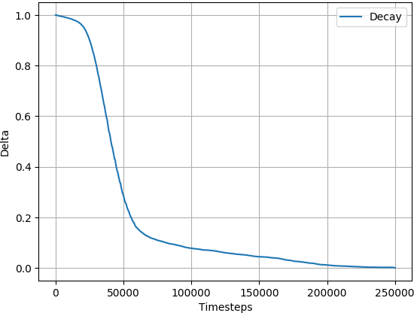
Friction-Based Decay
Chooses the decay factor based on the performance of the agent
Uses the speed of the sliding object as $δ$
The object is initialized with speed 1
and gradually slows down

Slide 13
Friction-Based Decay algorithm

Slide 14
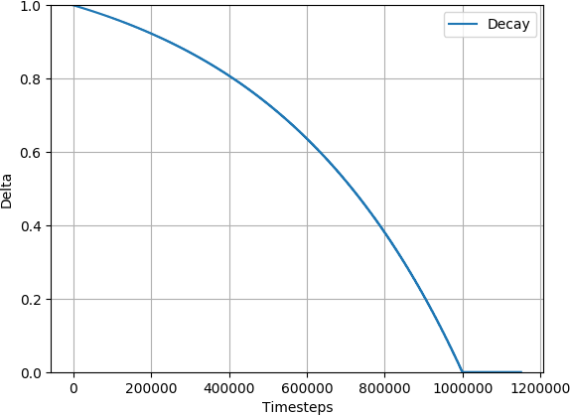
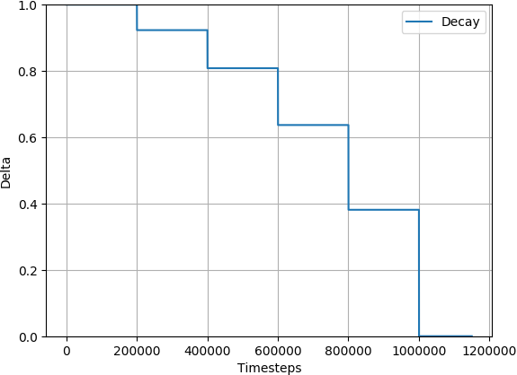
Curriculum Granularity
Larger granularity means more frequent updates
Smaller granularities are equivalent to a discrete curriculum

Slide 15
Predator-Prey
Grid world environment
The agent has to capture prey
and escape a predator
If the player survives for 1000
timesteps the episode ends

Slide 16
HFO
Multi-agent continuous environment
The goal is to coordinate to score
Both agents receive the same reward, and
have the same curriculum

Slide 17
Results - Granularity
Predator-Prey
HFO

Slide 18
Results - Different decay functions
Predator-Prey
HFO

Slide 19
Conclusion
Extended the definition of a curriculum to a continuous one
Defined the properties of a Continuous Curriculum
Introduced different decay functions
Explored the effects of changing the granularity
We demonstrated the performance of CCL on two domains

Slide 20
Any questions?

